Slide 1
ICMP Redirection

Slide 2
Introduction
ICMP route redirect message is normally sent by the default router to a host to indicate that there is a shorter route to some particular destinations.
Suppose there are two routers R1 (the default router) and R2 in a network and a host wants to send a packet outside the network.
The host sends the packet to R1.
R1 founds that a shorter route can be achieved if this packet was sent to R2.
R1 sends an ICMP redirect message to the host to inform it that subsequent packets should be sent to R2 instead.

Slide 3
Hacker can send a spoofed ICMP redirect message to achieve a similar effect of ARP cache poisoning.
The hacker tries to convince the target that the packet can send to the hacker’s machine to achieve a shorter route.

Slide 4
Internet Control Message Protocol (ICMP)
ICMP is designed to compensate for the deficiencies of Internet Protocol (IP)
IP has no error-reporting or error-correcting mechanism.
E.g. simply drop a datagram because no router is found or time-to-live field has a zero value.
IP also lacks a mechanism for host and management queries.
E.g. need information from other host or router.
Notes:
Time-to-live field (TTL): to prevent a packet to circulate in a network indefinitely. TTL will be decreased by one by every router and the packet is discarded if TTL becomes zero before reaching the destination
Ping: ICMP echo request

Slide 5
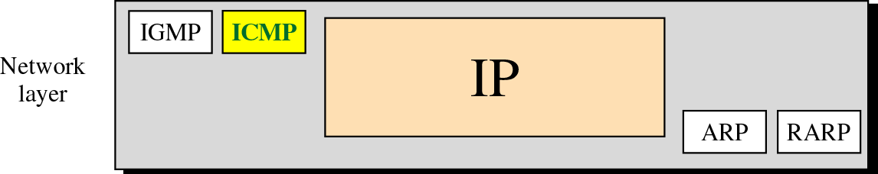
Position of ICMP in the network layer

Slide 6
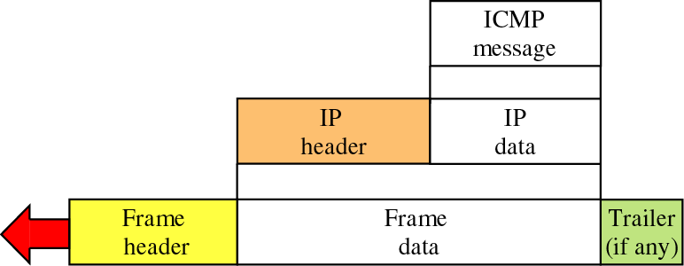
ICMP itself is a network layer protocol. However,
its messages are not passed directly to the data link layer.
Instead, the messages are first encapsulated inside IP datagrams.

Slide 7
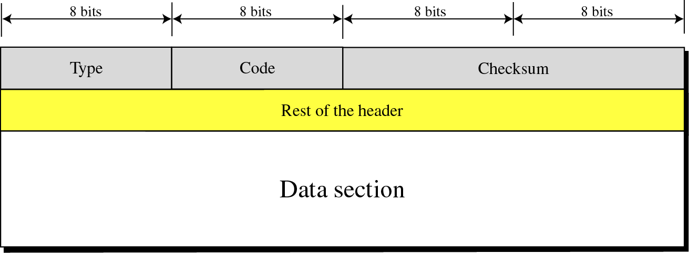
Figure 9-4
General format of ICMP messages

Slide 8
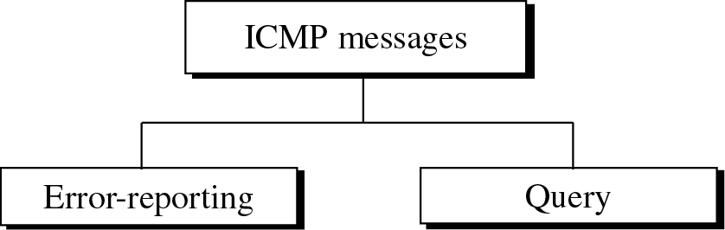
Types
3: Destination unreachable
4: Source quench
11: Time exceeded
12: Parameter Problem
5: Redirection
8,0: Echo request or reply
13,14: Timestamp request and
reply
17,18: Address mask request and
reply
10,9: Router solicitation and
advertisement
Notes:
Ping demo
Source quench: ask the other host to reduce to pace of sending packets
Router solicitation and advertisement: for router discovery

Slide 9
Redirection
When a router or a host needs to send a packet destined to another network, it must know the IP address of the next appropriate router.
Routers and hosts must have routing tables.
For efficiency, hosts usually do not take part in the routing update process.
Static routing.
Notes:
Demo:
Log packets to a host outside
route
arp

Slide 10
The routing table of a host usually has a limited number of entries.
Knows the IP of only one router, the default router.
The host may send a datagram (destined to another network) to a wrong router.
The router that receives the datagram will
forward the datagram to the correct router.
send an ICMP redirection message to the host to update its routing cache/table.

Slide 11
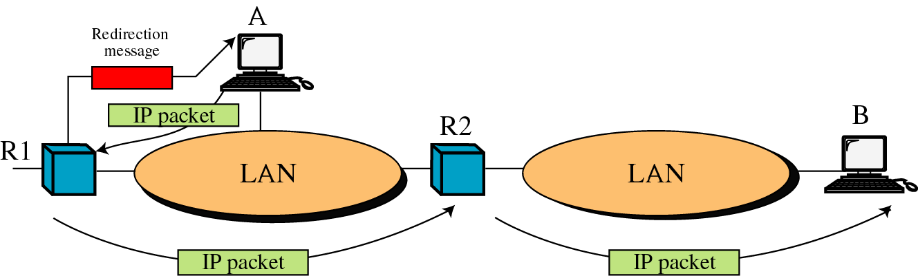
Figure 9-11
Tell A that next time the packet to B should be sent to R2 instead
LAN 1
LAN 2

Slide 12
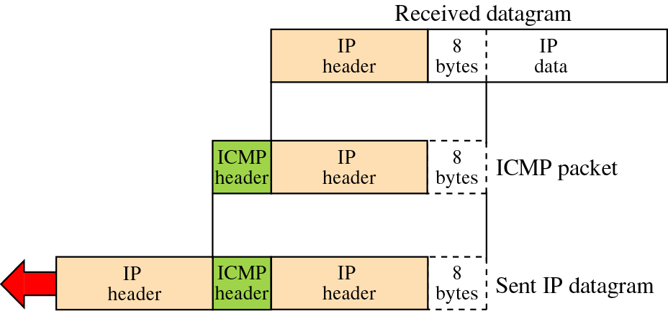
Figure 9-6
The first 8 bytes of the TCP/UDP header that stores the source port (2 bytes),
the destination port (2 bytes), and the sequence number (4 bytes, for TCP only)
Data packet received
by R1 from Host A
ICMP message sent by R1 to Host A
Embedded header

Slide 13
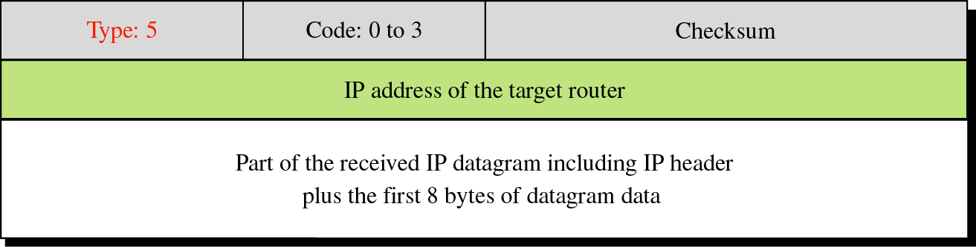
The first two rows: ICMP header on the previous page
Code 0: Redirection for network-specific route
Effective for the whole network
E.g., send to the new router if the packet is for any host in LAN2
Code 1: Redirection for host-specific route
Effective for a single host only
E.g., send to the new router if the packet is for Host B
Code 2: Redirection for network-specific route based
on the specified type of service.
Code 3: Redirection for host-specific route based
on the specified type of service.

Slide 14
VER | HLEN | Service Type | PACKET_LEN
Identification |  |  | Flag | Fragmentation offset
Time to live |  | Protocol (ICMP) | Header Checksum
Source IP address (R1)
Destination IP address (A)
Option
Type (5) |  | Code (1) | Checksum
IP address of the new router (R2)
VER | HLEN | Service Type | PACKET_LEN
Identification |  |  | Flag | Fragmentation offset
Time to live |  | Protocol (IPPROTO_IP) | Header Checksum
Source IP address (A)
Destination IP address (B)
Option
8 bytes of data
IP header
ICMP Header
Embedded header

Slide 15
Some hosts that receive an ICMP redirect message perform some checks before modifying their routing caches/tables.
These precautions are used to prevent a misbehaving router or host, or a malicious user, from incorrectly, modifying a system's routing cache/table.
However, it is not difficult to create a spoofed ICMP message, which can pass all these tests.

Slide 16
Common items that may be verified:
The new router must be on a directly connected network.
R2 must be in the same network.
The redirect message must be sent from the current router for that destination.
The sender of the redirect message has to be R1.
The redirect message cannot tell the host to use the sender of the redirect message as the router.
R1 will not ask the host to set R1 as the new router.
The route that's being modified must be an indirect route.
Host B is in a different LAN.

Slide 17
ICMP Spoofing
A hacker can create a spoofed ICMP redirect message to achieve a similar effect of ARP cache poisoning.
Suppose the hacker (10.1.51.3) tries to convince the target (10.1.51.1) that the shortest path to 1.2.3.4 is through 10.1.51.3.
Assume the original default router is 10.1.51.30.
The following spoofed packet will be sent.

Slide 18
VER | HLEN | Service Type | PACKET_LEN
Identification |  |  | Flag | Fragmentation offset
Time to live |  | Protocol (ICMP) | Header Checksum
Source IP address (10.1.51.30)
Destination IP address (10.1.51.1)
Option
Type (5) |  | Code (1) | Checksum
IP address of the new router (10.1.51.3)
VER | HLEN | Service Type | PACKET_LEN
Identification |  |  | Flag | Fragmentation offset
Time to live |  | Protocol (IPPROTO_IP) | Header Checksum
Source IP address (10.1.51.1)
Destination IP address (1.2.3.4)
Option
8 bytes of data
IP header
ICMP Header
Embedded header
No need to fill in the spoofed message
Notes:
Hacker: 10.1.51.3
Target: 10.1.51.1, which sends packets to 1.2.3.4
Default router: 10.1.51.30

Slide 19
Demonstration
We will use the program “icmp_redir.c”
Use Ethereal to capture several spoofed icmp redirect messages.
Use the command “route -nC” to show that the target machine will accept the redirect and updates its routing cache.
We can further show that subsequence packets sent to the original destination will be redirected to the hacker.
Notes:
Demo: ping a server outside
Send multiple ICMP packets:
./icmp_redir <default_gateway_ip> <target_ip> <target's dest host/ip> <hacker_ip>
route -nC
Command to clear the routing cache of the target:
ip route flush cache

Slide 20
ICMP Redirection vs. ARP Spoofing
 | ICMP Redirection | ARP Spoofing
Contain IP Header | Yes | No
Table to be Poisoned | Routing cache/table | ARP cache/table
Expire Time | Long / Won’t expire | Short
Original Destination of Target’s Packet | Hosts in different networks | Hosts in the same network

Slide 21
Possible Types of Attacks
Sniffing
Man-in-the-middle attack
Session hijack
DoS
The target can be stopped from talking to any particular address not on the same subnet, such as the DNS server

Slide 22
Preventions
Firewall
Block all the ICMP redirect messages coming outside the LAN.
It is not wise to rely on the LAN firewall only.
Cannot block those hackers that can access your LAN.
Simply stop the ICMP redirect features
Disable your host to accept any ICMP redirect message.

Slide 23
For redhat 6.2 or above
We must restart your network for the change to take effect
Change all eth1 in the above to eth0 if necessary
Edit the /etc/sysctl.conf file and add the following line:
# Disable ICMP Redirect Acceptance
net.ipv4.conf.all.accept_redirects = 0
net.ipv4.conf.eth1.accept_redirects = 0
/etc/rc.d/init.d/network restart
ifup eth1
Notes:
For our VMs, eth0 is for the hub and eth1 is for the switch.

Slide 24
References
Yuri Volobuev, “Playing redir games with ARP and ICMP”, it doesn’t seem to be published formally.
Forouzan, “TCP/IP protocol Suite”., Chapter 9. (Introduction to ICMP)

